Slide 1
70-533 : Implementing Microsoft Azure Infrastructure Solutions

Slide 2
Configure VN

Slide 3

Ans = E
Network information is stored in the cscfg file

Slide 4

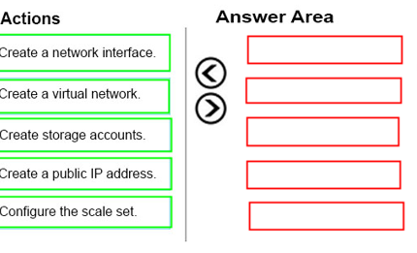
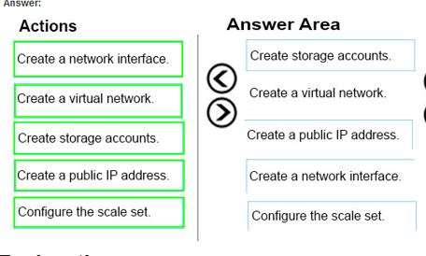
Ans =

Slide 5

Ans =A & D
New-AzureQuickVM
Creates and provisions a new Azure virtual machine.
the virtual machine. You can create a new Azure service for the virtual machine by specifying either the Location or AffinityGroup parameters, or deploy the new virtual machine into an existing service

Slide 6
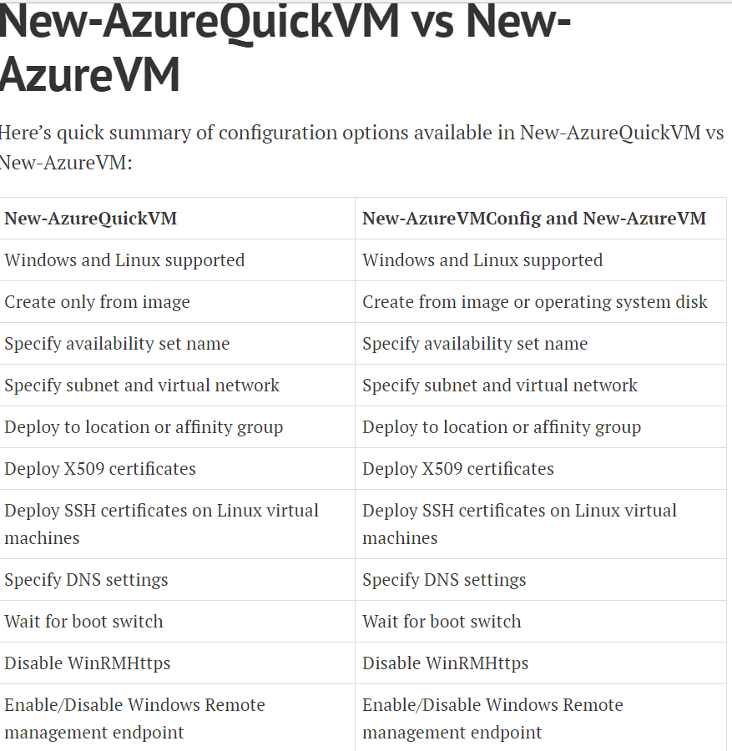

Slide 7
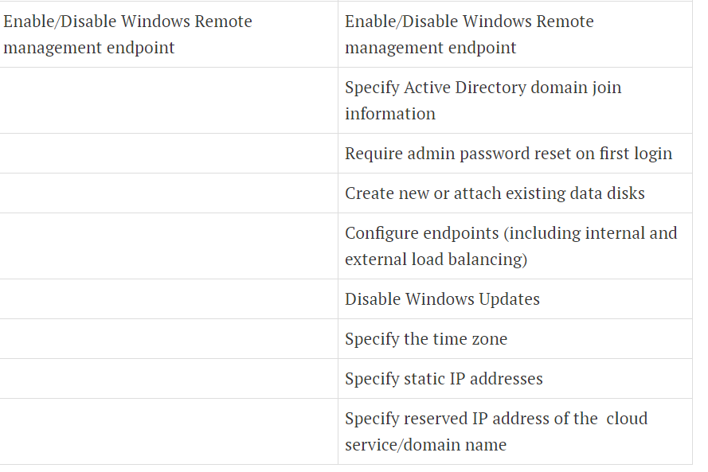

Slide 8
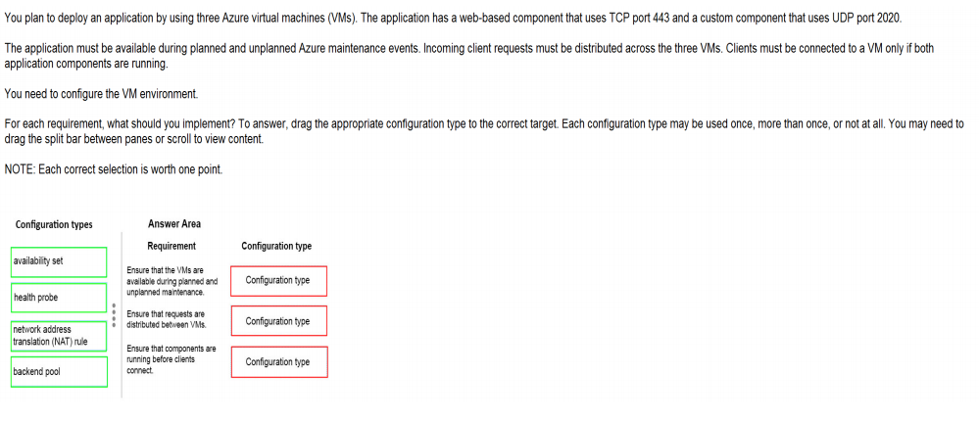
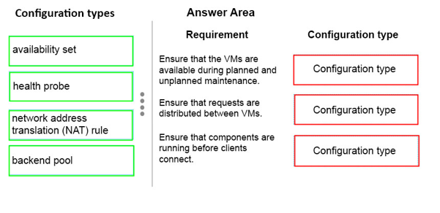
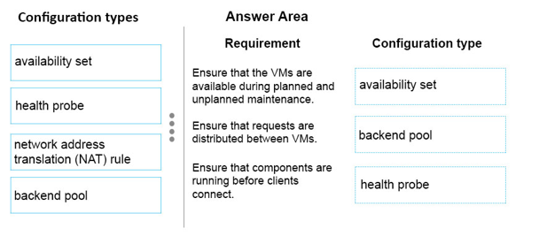
Ans =

Slide 9
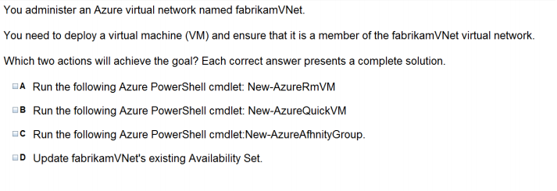
Ans = A & b The New-AzureQuickVM cmdlet sets the configuration for a new virtual machine and creates the virtual machine. You can create a new Azure service for the virtual machine by specifying either the Location or AffinityGroup parameters, or deploy the new virtual machine into an existing service.

Slide 10
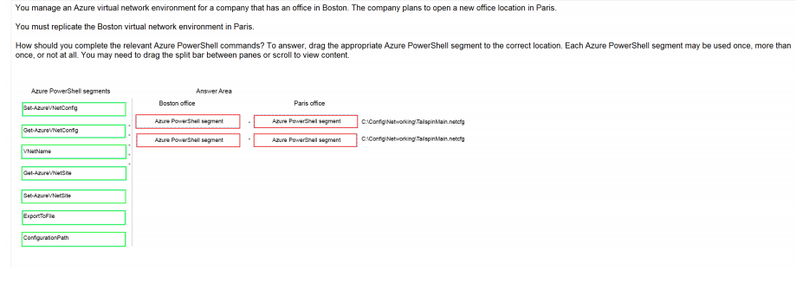
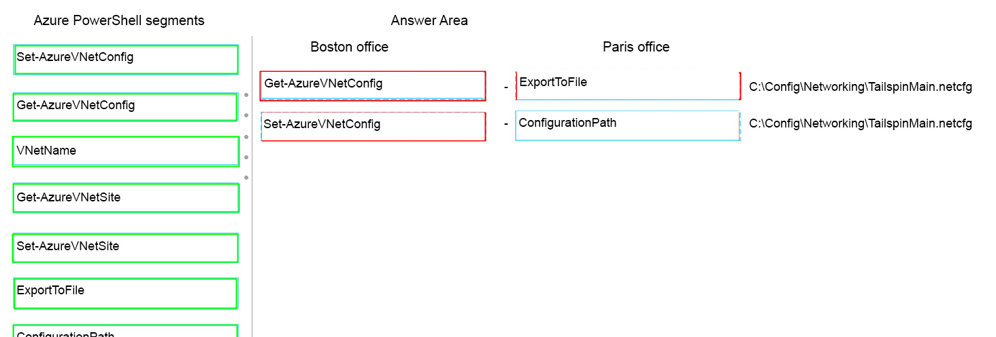
Ans =

Slide 11
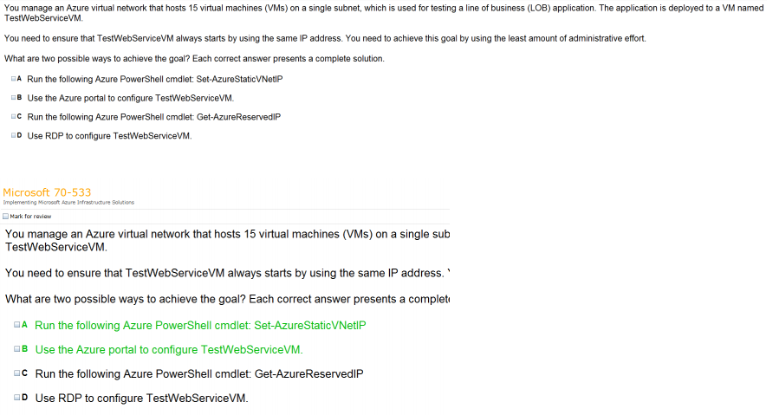
Ans =

Slide 12

Ans = B

Slide 13
Modify Virtual Network

Slide 14
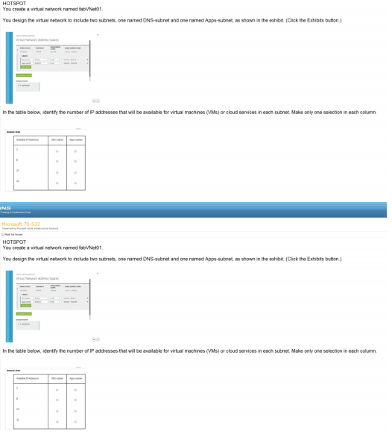
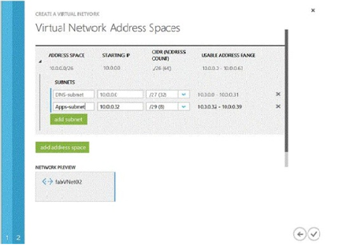
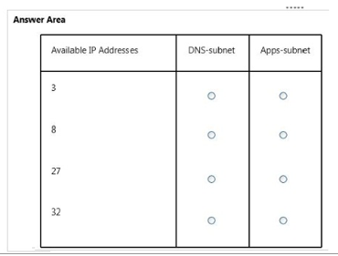
Ans – DNS – 27 & Apps Subnet - 3

Slide 15
Design & Implement Multi Site and Hybrid Network

Slide 16
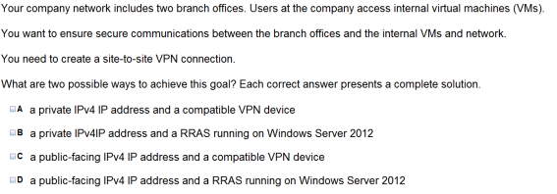

Ans = C & D Video Vnet to Vnet and Point to Site

Slide 17

Ans – B What to Explain Point to Site Video Steps

Slide 18
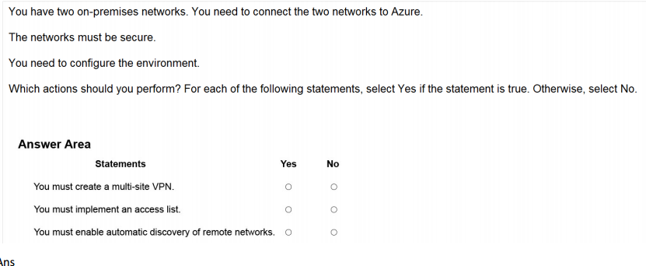

Ans =

Slide 19
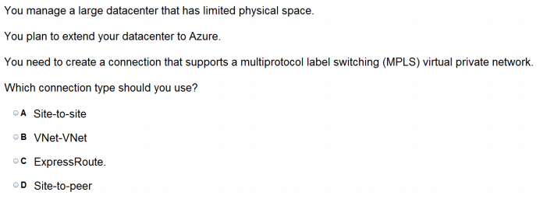
Ans = C

Slide 20
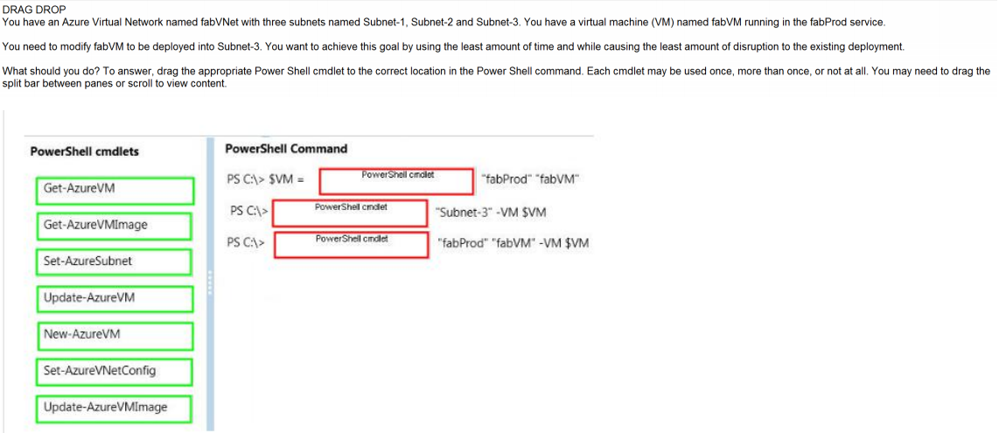
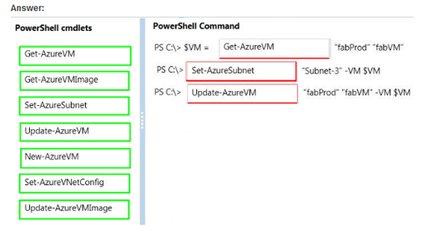
Ans =

Slide 21
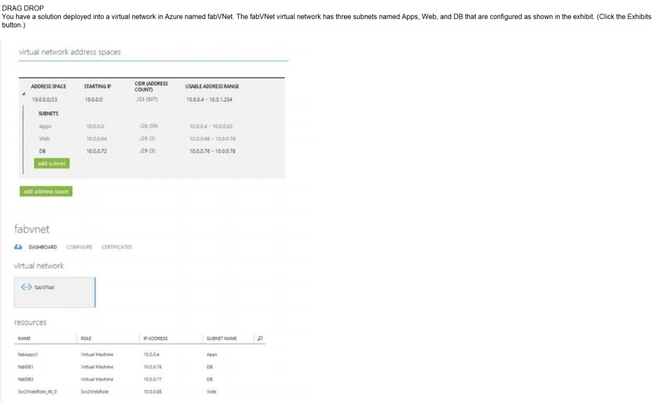
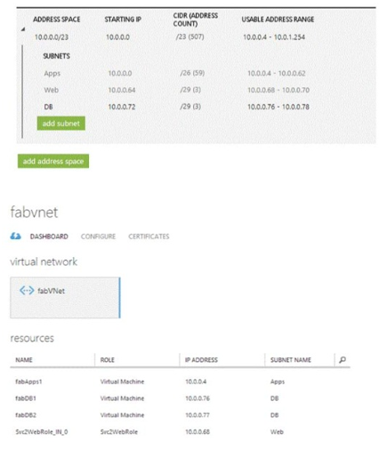
Ans =

Slide 22


Slide 23
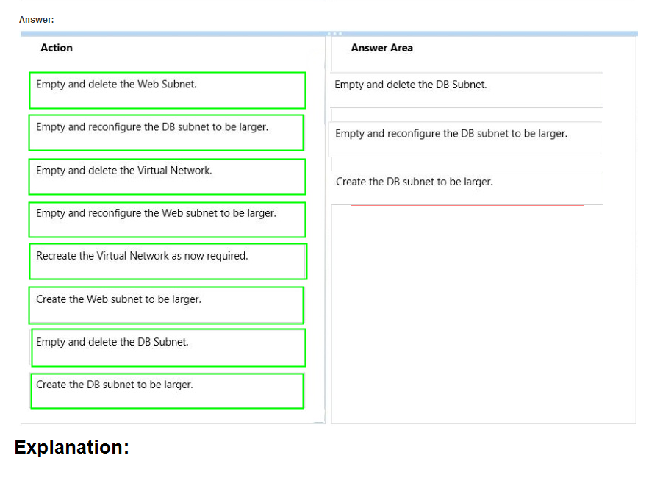
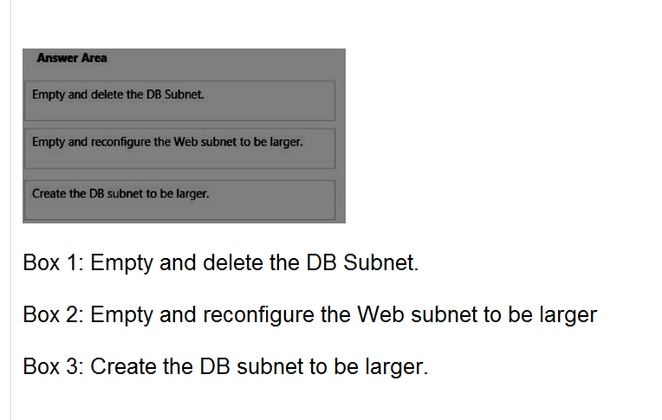

Slide 24

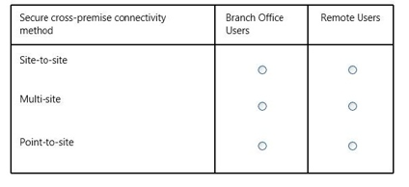
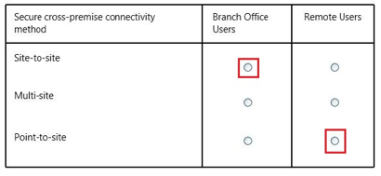
Ans =

Slide 25
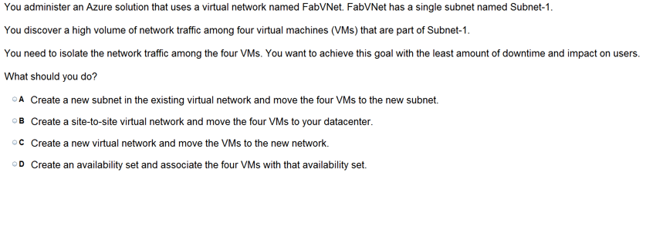
Ans =C

Slide 26

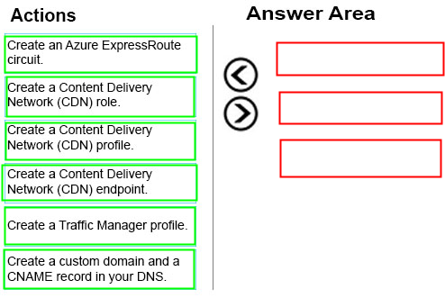
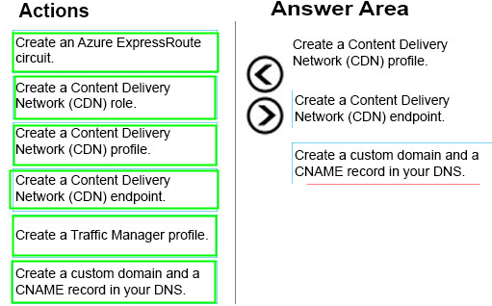
Ans =

Slide 27
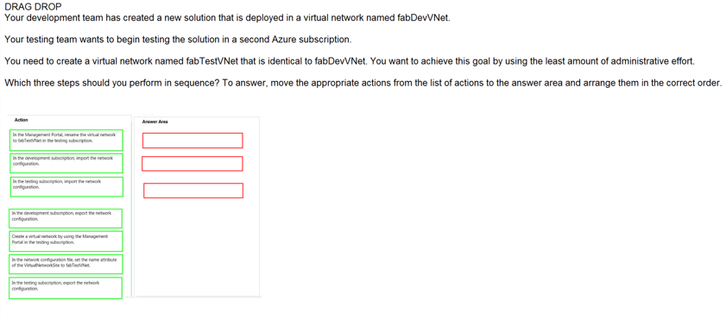
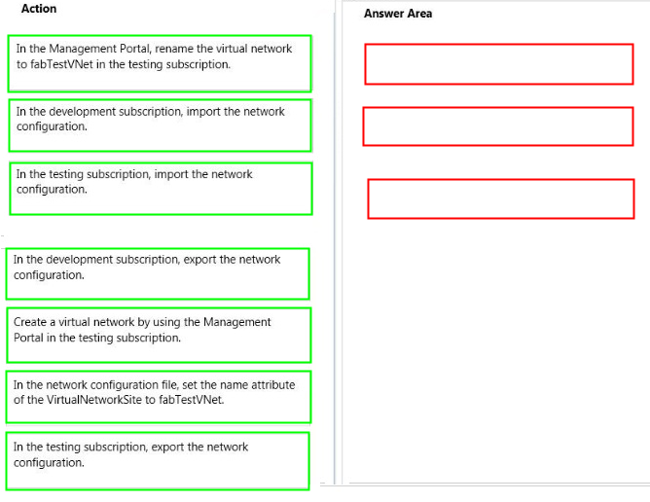
Ans =

Slide 28
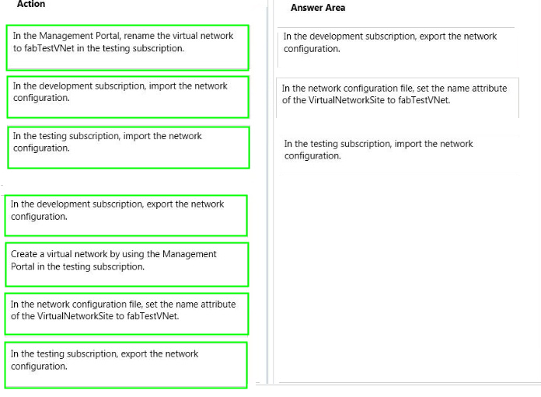

Slide 29

Ans =A

Slide 30

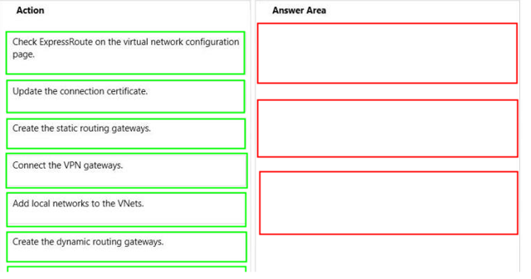
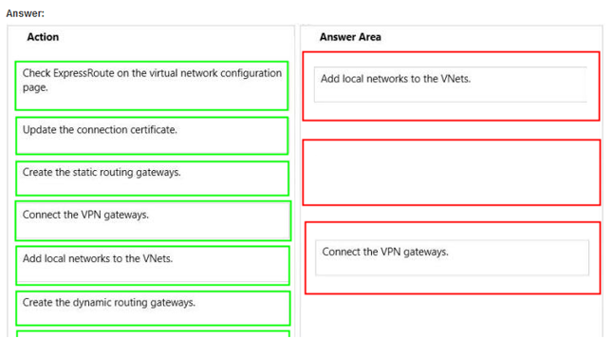
Ans =

Slide 31


